Slide 1

GEOSYNTHETICS
Prepared By: Saurabh shah
Code: 1710

Slide 2
Geosynthetics – a planar product manufactured from polymeric materials used with rock, earth, or other geotechnical engineering related material as an integral part of a human-made project, structure, or system.

Slide 3
“GEOSYNTHETICS ARE NEW BUT THE CONCEPT IS NOT”

Slide 4
CONTENTS
Concept of geosynthetics
Role of geosynthetics
Geosynthetics products
Application of geosynthetics in construction industry
Geosynthetic products of natural material
Areas of application
Test for Geosynthetics
Advantages
Analysis of present scenario (Usage, graphs)
Use of geosynthetics in field (PICTURES)

Slide 5
The term ‘Geosynthetics’ has two parts: the prefix ‘geo’, referring to an end use associated with improving the performance of civil engineering works involving earth/ground/soil and the suffix ‘synthetics’, referring to the fact that the materials are almost exclusively from man-made products. The materials used in the manufacture of geosynthetics are primarily synthetic polymers generally derived from crude petroleum oils; although rubber, fiberglass, and other materials are also sometimes used for manufacturing geosynthetics.

Slide 6
Geosynthetics are usually sheet materials supplied in roll form and they are used in many geotechnical applications.
There are five categories - geogrids, geomembranes, geonets, geotextiles and related products (materials such as erosion mats) that do not fall naturally into one of the other four categories.
There are six main functions that these materials can provide and many products provide one of more of these, particularly the geocomposites which, as the name suggests, are made up of multiple components.

Slide 7
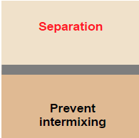
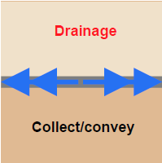
Roles of geosynthetics :
Preventing intermixing of soil types
or soil/aggregate to maintain the
integrity of each material yet still
allow the free passage of
liquids/gases. Commonly used in
between sub-base/subgrade and
around drainage materials.
Allowing fluids and gases to flow
both through the plane of the
material. Commonly used as
components in geocomposites used
for surface water runoff or for gas
collection under membranes.

Slide 8
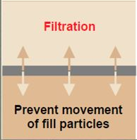
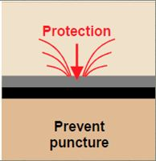
Restraining soil particles subject to
hydraulic forces whilst allowing the
passage of liquids/gases. This
function is often partnered with
separation e.g. in coastal defence
applications or wrapped drains.
Preventing or limiting localised
damage to an adjacent material,
usually a geomembrane used to line a lagoon or a landfill. Thick
geotextiles prevent puncture or
excessive strain in the membrane.

Slide 9
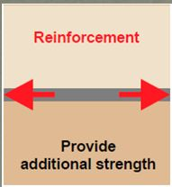
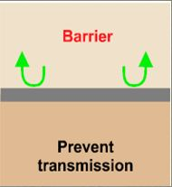
Providing additional strength to soils to enable steep slopes and soil structures to be constructed, and allow construction over weak and variable soils.
Isolating one material from another. The most frequent use of this function is in landfills where impermeable linings prevent contamination of surrounding soils.

Slide 10
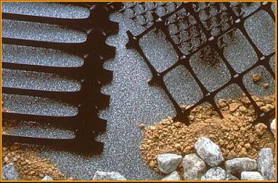
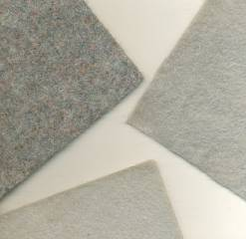
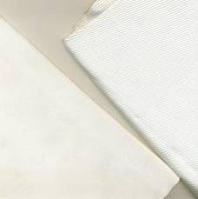
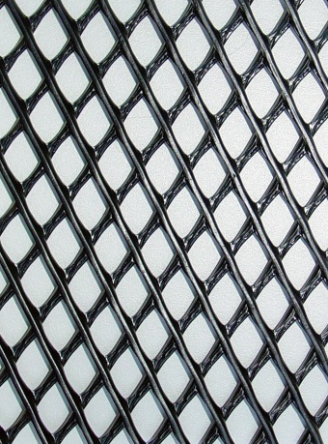
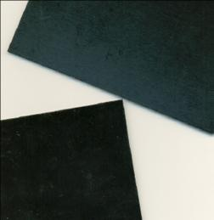
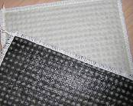
Geogrids (Uniaxial &Biaxial)
Geotextiles
Nonwoven
Woven
Geonet
Geosynthetic Clay Liners
Geomembranes

Slide 11
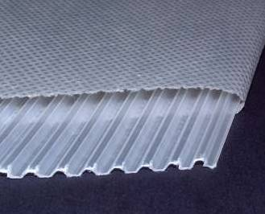
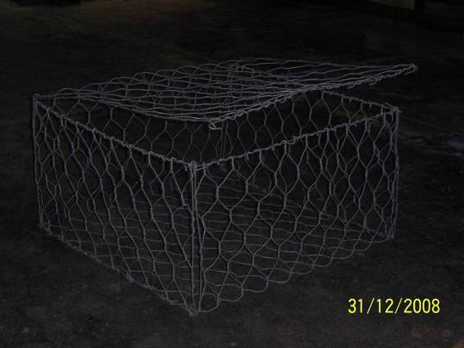
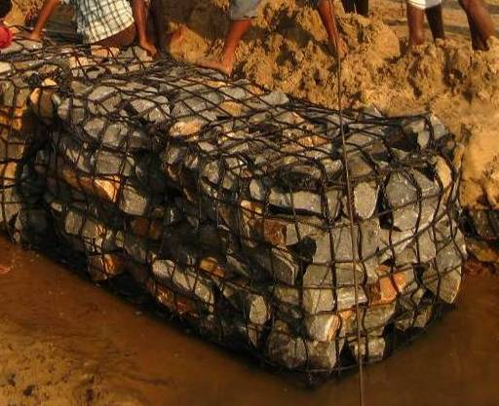
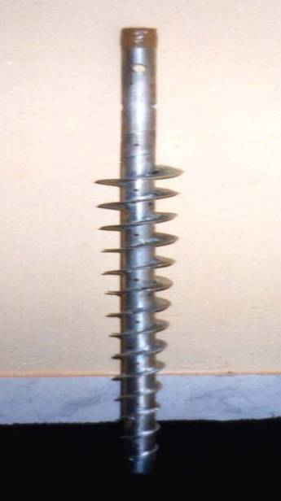
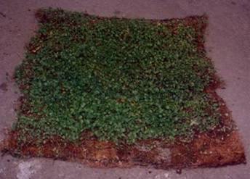
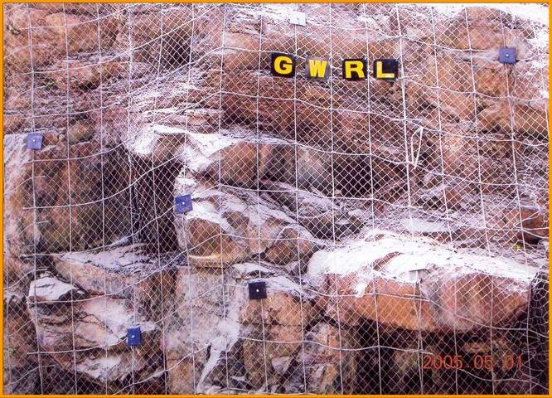
Gabions
PVD
Steel Wire
Polymer Rope
Anco Drain
GARMAT
Boulder Net

Slide 12
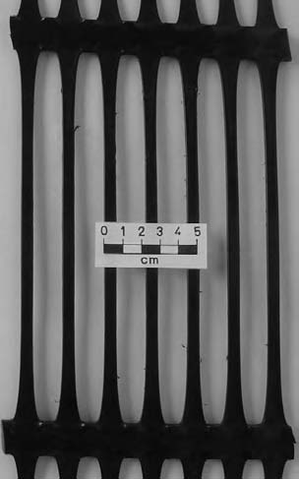
Uniaxial geogrid:
A geogrid produced by the longitudinal stretching of a regularly punched polymer sheet, and therefore it possesses a much higher tensile strength in the longitudinal direction than the tensile strength in the transverse direction.

Slide 13
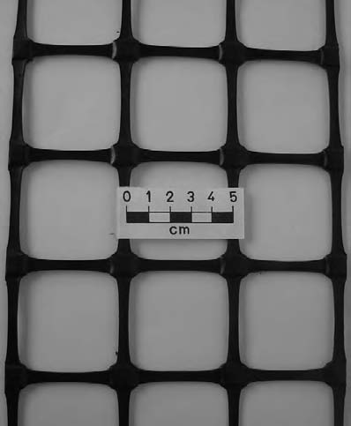
Biaxial geogrid:
A geogrid produced by stretching in both the longitudinal and the
transverse directions of a regularly punched polymer sheet, and therefore it possesses equal tensile strength in both the longitudinal and the transverse directions.

Slide 14
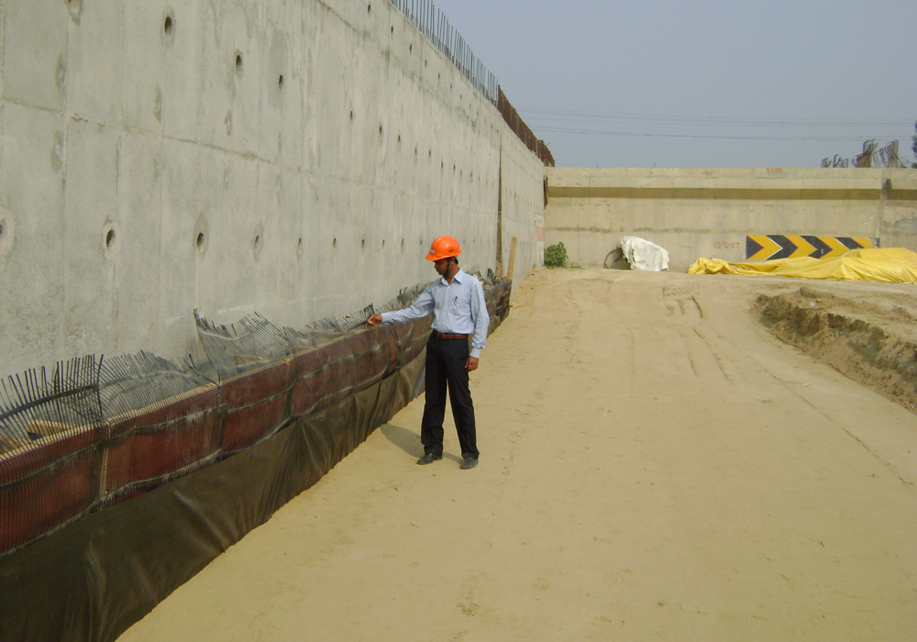
Filter - Woven geotextiles
Geogrid Wraparound Wall at CH. 48 KM & CH. 50 KM,
Lucknow - Muzaffarpur National Highway Project

Slide 15
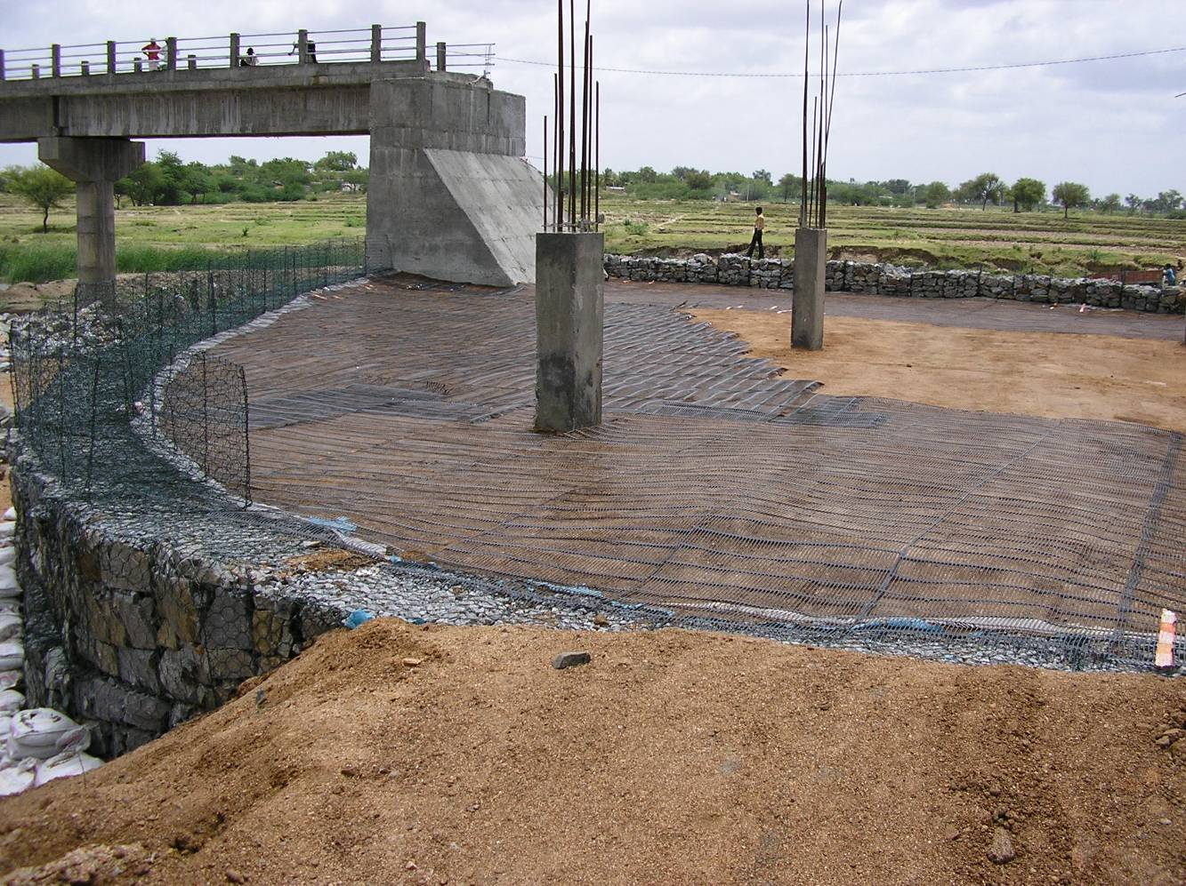
RS Wall with Gabion Facia and Geogrid as reinforcement at Bellary, Karnataka)

Slide 16
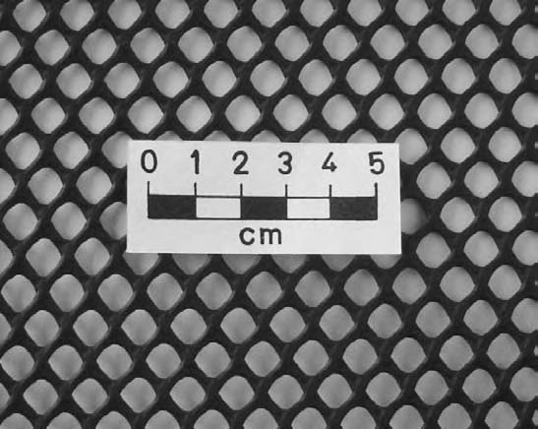
Geonet:
It is a planar, polymeric product consisting of a regular dense network of
integrally connected parallel sets of ribs overlying similar sets at various angles. At first glance, geonets appear similar to geogrids; however, geonets are different from geogrids, not mainly in the material or their configuration but in their functions to perform the in-plane drainage of liquids or gases.

Slide 17
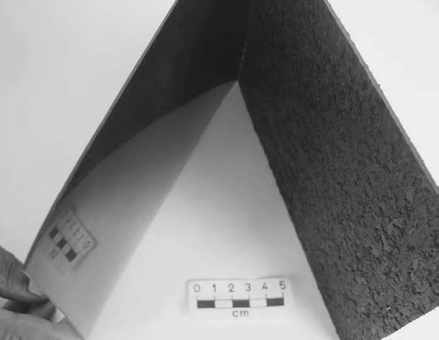
Geomembrane:
It is a planar, relatively impermeable, synthetic sheet manufactured from materials of low permeability to control fluid migration in a project as a barrier or liner. The materials may be polymeric or asphaltic or a combination thereof. The term barrier applies when the geomembrane is used inside an earth mass. The term liner is usually reserved for the cases where the geomembrane is used as an interface or a surface revetment.

Slide 18
Mainly used for:
Water conservation projects (Agricultural ponds, Fire water holding ponds, Raw water reservoir or lakes, etc.)
Water transport projects (Canal lining, Drainage lining, Embakment protection liner, etc.)
Water treatment projects
Land fill projects

Slide 19
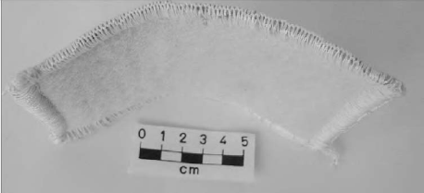
Geocomposite:
It is a term applied to the product that is assembled or manufactured in laminated or composite form from two or more materials, of which one at least is a geosynthetic (geotextile, geogrid, geonet, geomembrane, or any other type), which, in combination, performs specific function(s) more effectively than when used separately .
Clay liner

Slide 20
There are a number of geosynthetics available today, including webs, grids, nets, meshes, and composites, which are technically not textiles; however, they are used in combination with or in place of geotextiles. All such products are often called geotextilerelated products (GTP). Some common GTP and other types of geosynthetics are briefly described below.
Geocell:
A three-dimensional, permeable, polymeric honeycomb or web structure, assembled from geogrids and special bodkins couplings in triangular or square cells or produced in the factory using strips of needle-punched polyester or solid
high density polyethylene (HDPE).
Geofoam:
A polymeric material manufactured by the application of the polymer in semi-liquid form through the use of a foaming agent to have a lightweight material in slab or block form with high void content for use as lightweight fills, thermal insulators and drainage channels.

Slide 21
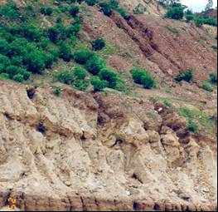
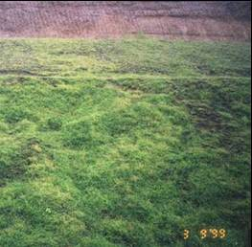
Geomat: A three-dimensional, permeable, polymeric structure made of coarse and rigid filaments bonded at their junctions used to reinforce roots of vegetation such as grass and small plants and extend the erosion control limits of vegetation for permanent installation.
Before
After
GarmatTM Erosion Control Mat
(Mahanadi Coal Fields, Talcher, Orissa)

Slide 22
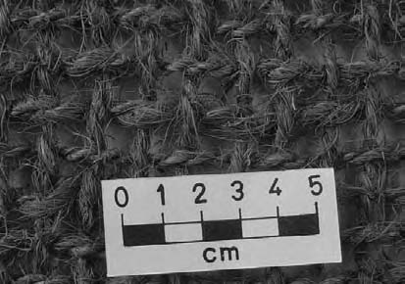
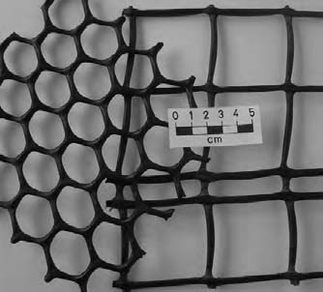
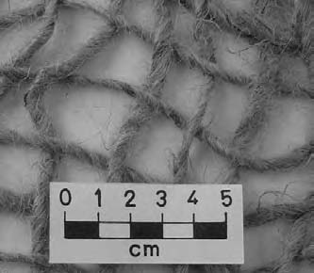
Geomesh: A geosynthetic or geonatural generally with a planar woven structure having large pore sizes, which vary from several millimetres to several centimetres for use in mainly erosion control works .
Woven coir type Plastic type
Woven jute

Slide 23
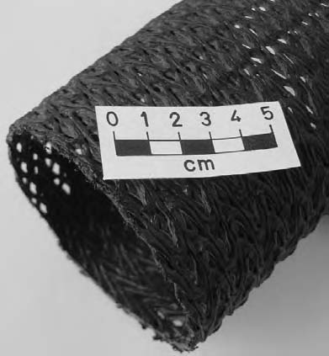
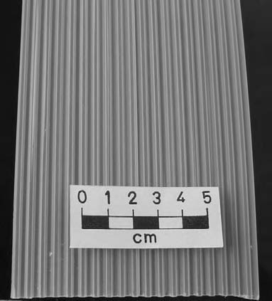
Geopipe: A plastic pipe (smooth or corrugated with or without perforations) placed beneath the ground surface and subsequently backfilled.
Geopipe Geospacer
Geospacer: A three-dimensional polymeric moulded structure consisting of cuspidated or corrugated plates with large void spaces.
Geostrip: A polymeric material in the form of a strip.

Slide 24
The rapid growth in the past four decades all over the world is due mainly to the following favourable basic characteristics of geosynthetics:
non-corrosiveness
highly resistant to biological and chemical degradation
long-term durability under soil cover
high flexibility
minimum volume
lightness
ease of storing and transportation
simplicity of installation
speeding the construction process
making economical and environment-friendly solution
providing good aesthetic look to structures.
The importance of geosynthetics can also be observed in their ability to partially or completely replace natural resources such as gravel, sand, bentonite clay, etc. In fact, geosynthetics can be used for achieving better durability, aesthetics and environment of the civil engineering projects.

Slide 25
Raw materials
Almost exclusively, the raw materials from which geosynthetics are produced are polymeric.
Polymers are materials of very high molecular weight and are found to have multifarious applications in the present society.
The polymers used to manufacture geosynthetics are generally thermoplastics, which may be amorphous or semi-crystalline. Such materials melt on heating and solidify on cooling. The heating and cooling cycles can be applied several times without affecting the properties.
Any polymer, whether amorphous or semi-crystalline, consists of long chain molecules containing many identical chemical units bound together by covalent bonds. Each unit may be composed of one or more small molecular compounds called monomers, which are most commonly hydrocarbon molecules.
The process of joining monomers, end to end, to form long polymer chains is called polymerization.
Manufacture of polymers is generally carried out by chemical or petrochemical companies who produce polymers in the form of solid pellets, flakes or granules.

Slide 26
Geosynthetic products of natural material
Although most of the geosynthetics are made from synthetic polymers, a few specialist geosynthetics, especially geotextiles, may also incorporate steel wire or natural biodegradable fibres such as jute, coir, paper, cotton, wool, silk, etc.
Biodegradable geotextiles are usually limited to erosion control applications where natural vegetation will replace the geotextile’s role as it degrades. Jute nets are marketed under various trade names, including geojute, soil saver, and anti-wash.
They are usually in the form of a woven net with a typical mesh open size of about 10 by 15 mm, a typical thickness of about 5 mm and an open area of about 65%.
Vegetation can easily grow through openings and use the fabric matrix as support. The jute, which is about 80% natural cellulose, should completely degrade in about two years. An additional advantage of these biodegradable products is that the decomposed jute improves the quality of the soil for vegetation growth.

Slide 27
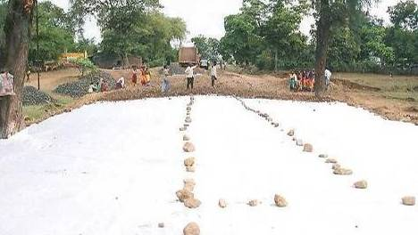
Woven Geotextile - Separator (Thane, Mumbai)

Slide 28
Areas of Application
Environmental Protection
Infrastructure Development
Land Engineering
Coastal Protection
Rock fall protection
Canal Lining
Flood Control
Roads
Railways
Ground Improvement
Slope Stabilization

Slide 29
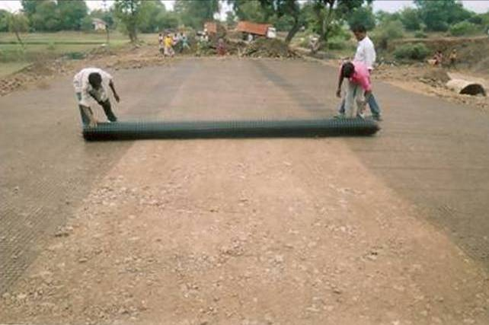
Environmental Protection
Land Engineering
Subgrade Stabilization using Tensar Biaxial Geogrids
Talasari - Udhava Major Dist. Road, PWD, Maharashtra

Slide 30
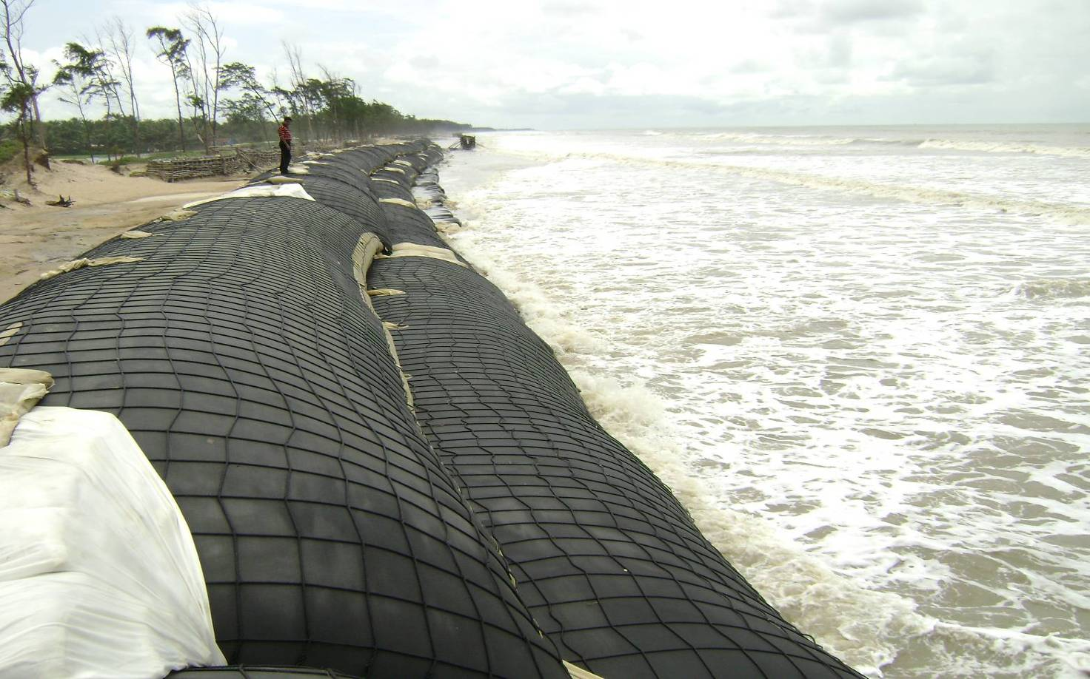
Coastal Protection
After installation - During High Tide

Slide 31
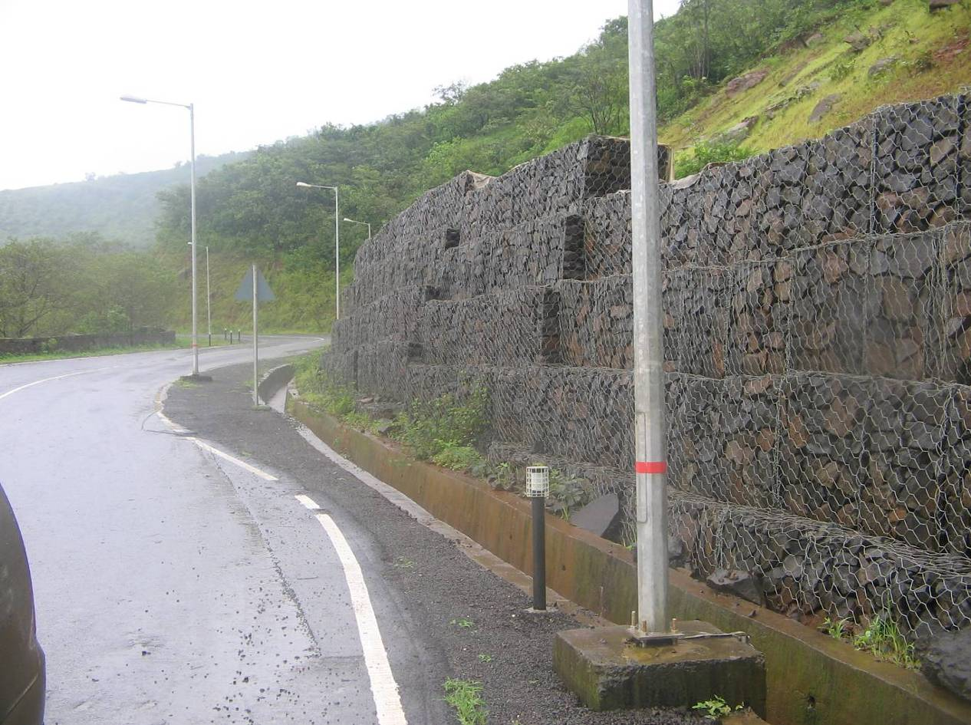
Rock fall protection
Gabion Retaining Wall – Lavasa

Slide 32
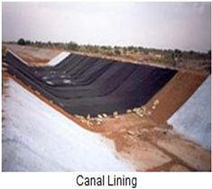
Canal Lining

Slide 33
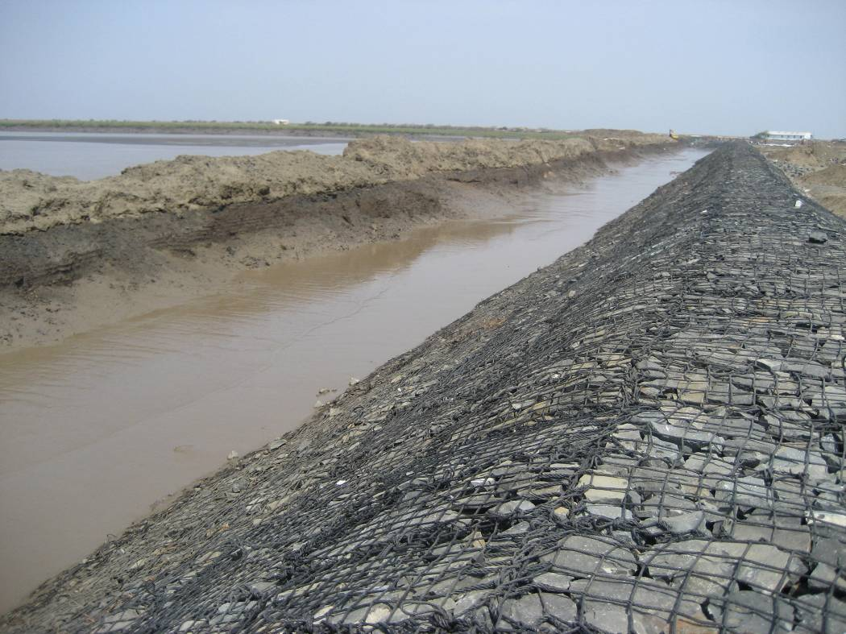
Revetment - Anti Erosion Sea Bund
Morbhagwa, Gujarat, India

Slide 34
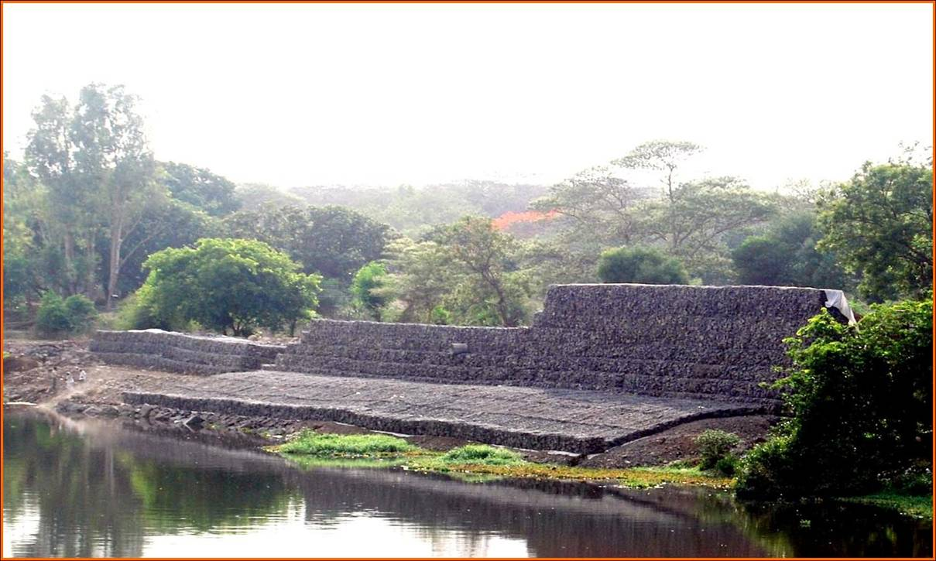
Flood Control
Flood Protection Works, Mula River, Pune

Slide 35
Infrastructure development Roads
Roads often have to be constructed across weak and compressible soil subgrades. It is therefore common practice to distribute the traffic loads in order to decrease the stresses on the soil subgrade.
This is generally done by placing a granular layer over the soil subgrade. The granular layer should present good mechanical properties and enough thickness.
The long-term interaction between a fine soil subgrade and the granular layer, under dynamic loads, is likely to cause pumping erosion of the soil subgrade and penetration of the granular particles into the soil subgrade, giving rise to permanent deflections and eventually to failure.
At present, geosynthetics are being used to solve many such problems.

Slide 36
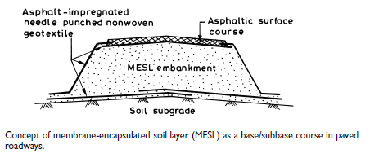

Slide 37
Railways
Railway tracks serve as a stable guide way to trains with appropriate vertical and horizontal alignment.
To achieve this role each component of the track system must perform its specific functions satisfactorily in response to the traffic loads and environmental factors imposed on the system.
Geosynthetics play an important role in achieving higher efficiency and better performance of modern-day railway track structures. They are nowadays used to correct some track support problems.
Acceptance and use of geotextiles for track stabilization is now common practice in the USA, Canada and Europe.
Geotextiles are also being used in high maintenance locations such as turnouts, rail crossings, switches and highway crossings. One of the most important areas served by geotextiles is beneath the mainline track for stabilization of marginal or poor subgrade, which can suffer from severe mud-pumping and subsidence.

Slide 38
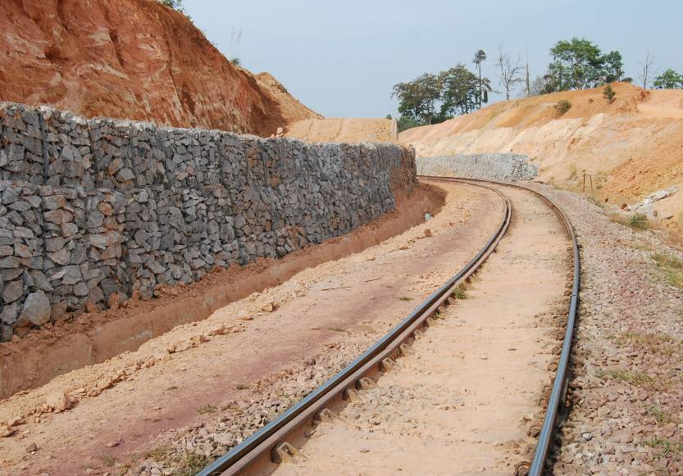
Slope Retention works at Sakleshpur – Subhramanya Road Section, South Western Railways, Mysore Division

Slide 39
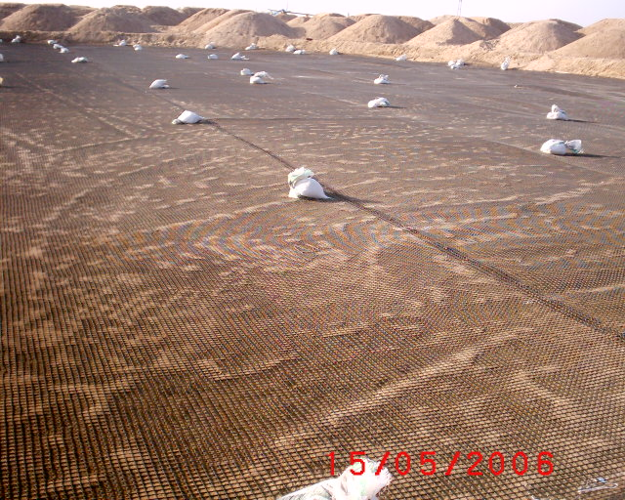
Ground Improvement
Ground Improvement for Tank Foundation, HPCL, Mundra, Gujarat

Slide 40
Slope Stabilization
In recent years geosynthetic-reinforced slopes have provided innovative and cost-effective solutions to slope stabilization problems, particularly after a slope failure has occurred or if a steeper than safe unreinforced slope is desirable. They provide a wide array of design
advantages as mentioned below :
reduce land requirement to facilitate a change in grade;
provide additional usable area at toe or crest of slope;
use available on-site soil to balance earthwork quantities;
eliminate import costs of select fill or export costs of unsuitable fill;
meet steep changes in grade, without the expense of retaining walls;
eliminate concrete face treatments, when not required for surficial stability or erosion control;
provide a natural vegetated face treatment for environmentally sensitive areas;
offer a design that is easily adjustable for surcharge loadings from buildings and vehicles.

Slide 41
Tests for geosynthetics
UV resistance
Chemical and biological resistance
Fire resistance
Mechanical damage resistance
Toxicity
Water flow or permeability
Tensile strength
Shear resistance

Slide 42
ADVANTAGES
Saving in labour
Construction is easy and speedy
Easy for complicated structures
No noise pollution
Aesthetically good and eco-friendly
Reliable and easy to install
Lightweight with minimum
maintenance.
Geosynthetics have low handling and overall costs.

Slide 43
CONSUMPTION OF TECHNICAL TEXTILES BY REGION (SOURCE: DRA REPORT)
REGION / COUNTRY
2005
2005
2010
2010
05 - 10
VOL. (mn T)
VALUE (US$ bn)
VOL. (mn T)
VALUE (US$ bn)
CAGR % (VOL.)
EUROPE (WEST)
4.107
23.968
4.760
21.047
3.0
EUROPE (EAST)
0.666
4.583
0.817
5.225
4.2
AMERICA (NORTH)
4.774
23.710
5.591
27.561
3.2
AMERICA (SOUTH)
1.004
6.348
1.230
7.255
4.1
ASIA
INDIA
8.091
1.573
48.401
4.905
10.156
2.075
65.156
6.774
5.0
5.8
OCEANIA
0.116
0.578
0.141
0.712
3.9
TOTAL
19.683
106.899
23.774
127.28
3.87

Slide 44
TECHNICAL TEXTILE CONSUMPTION BY REGION

Slide 45
FIBRE-WISE CONSUMPTION
POLYESTER - 25 %
POLYOLEFINS - 25 %
GLASS - 15 %
JUTE, COIR, ETC. - 14 %
COTTON - 7 %
VISCOSE - 3 %
OTHER CELLULOSICS - 3 %
POLYAMIDE - 7 %
ARAMID AND CARBON FIBRES - 1 %

Slide 46
FIBRE CONSUMPTION IN TECHNICAL TEXTILES IN INDIA

Slide 47
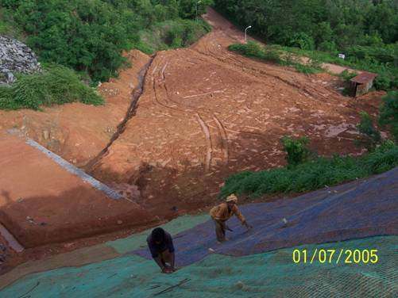
Anco Drain

Slide 48
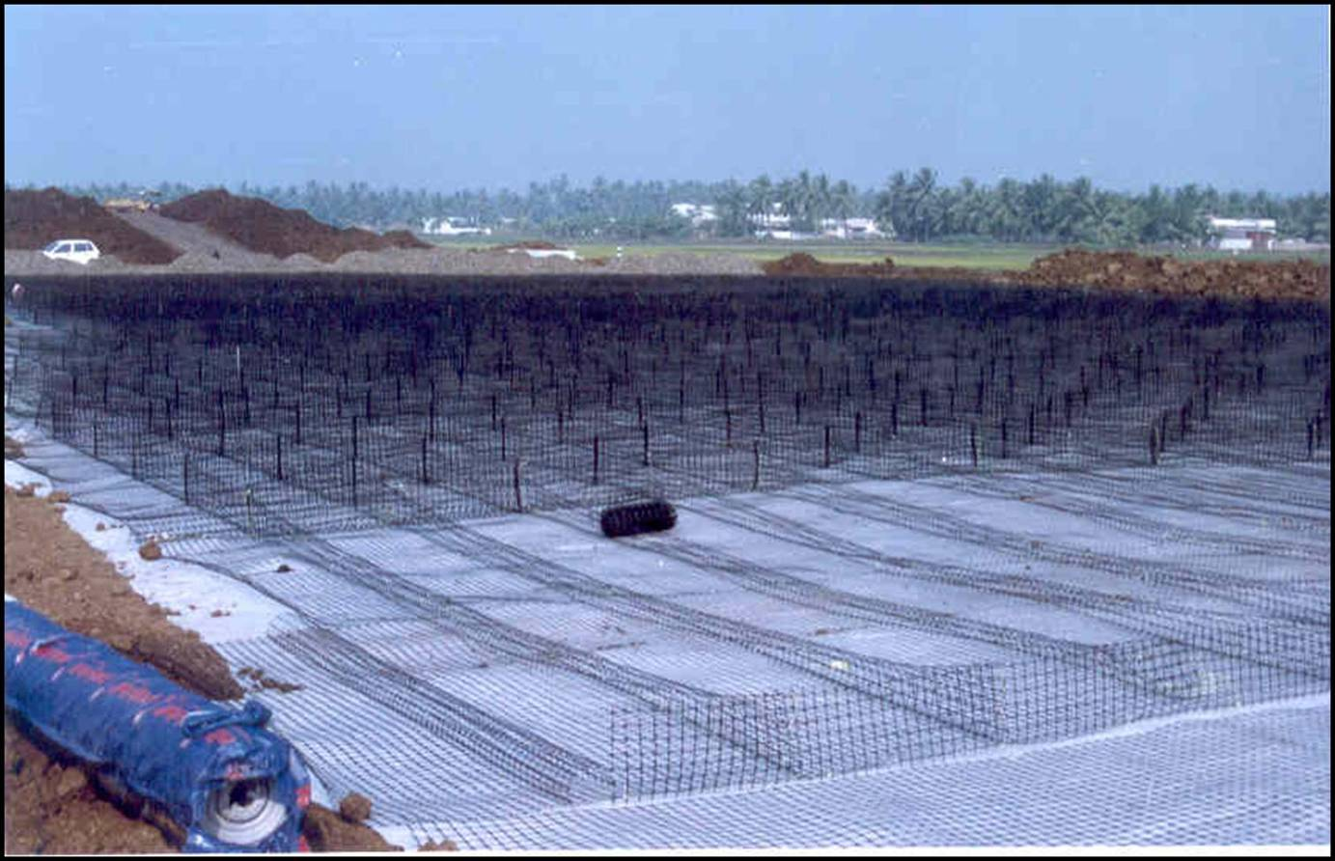
Separator - Approach Embankment for Bridge across Vasista, Godavari at Chinchinada, A.P. (N H 5A)3

Slide 49
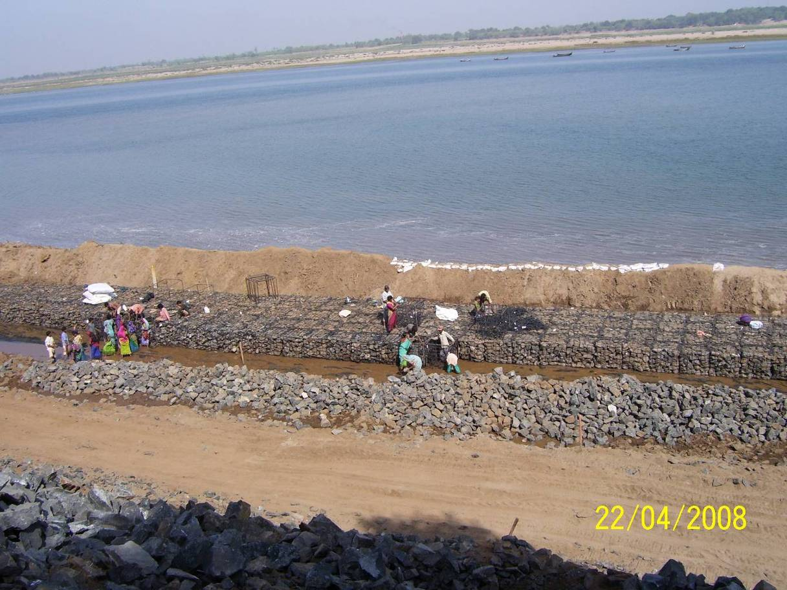
Narmada Bank Protection Works, Madhi, Gujarat

Slide 50
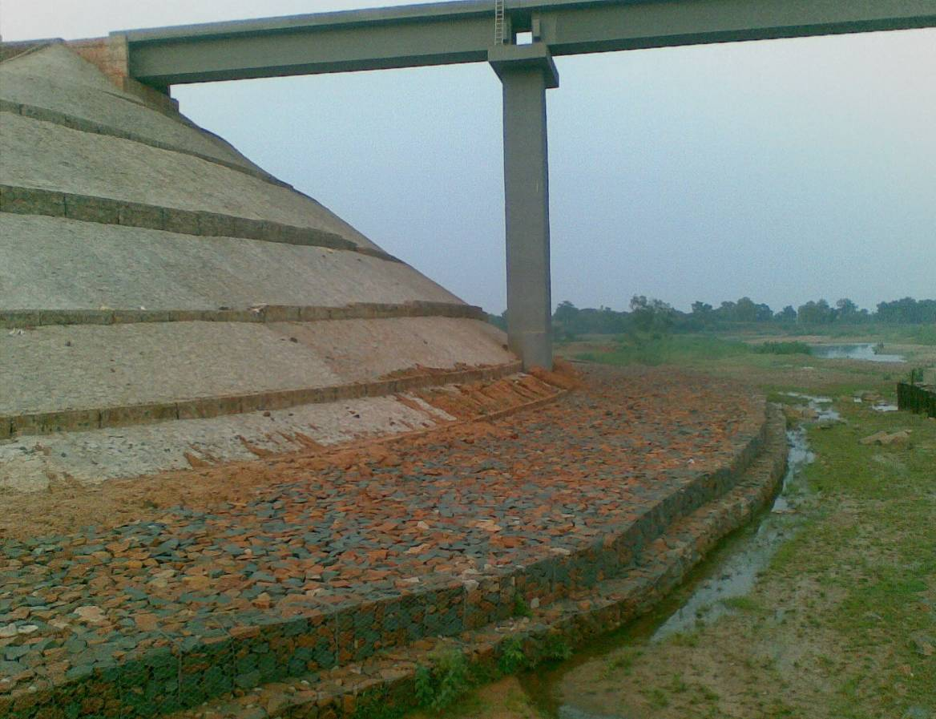
Abutment Protection Works, JJKR Section & DKB Line, East Coast Railways

Slide 51
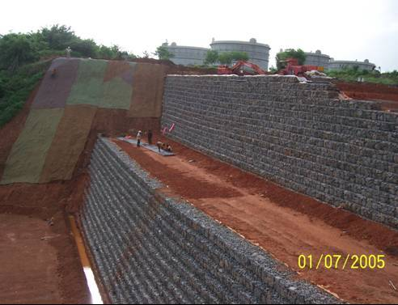
GarmatTM
Reinforced
Soil
Gabion Facia
Reinforced Soil System with Gabion Facia, MRPL, Mangalore

Slide 52
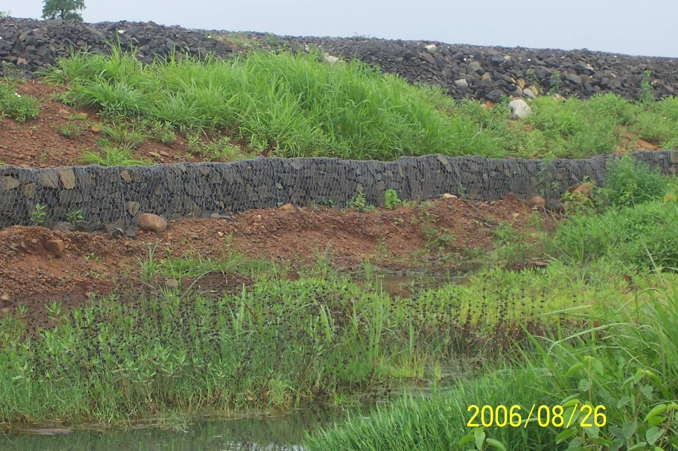
Toe Protection Works – Central Railways

Slide 53
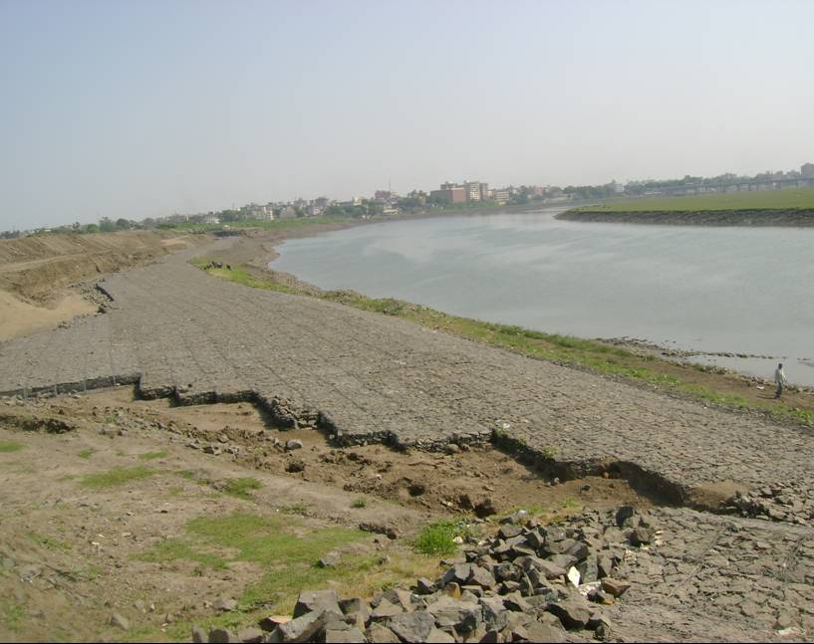
Tapi River Bank Protection under Construction using Steel Gabions, Barimata, Surat, Gujarat)

Slide 54
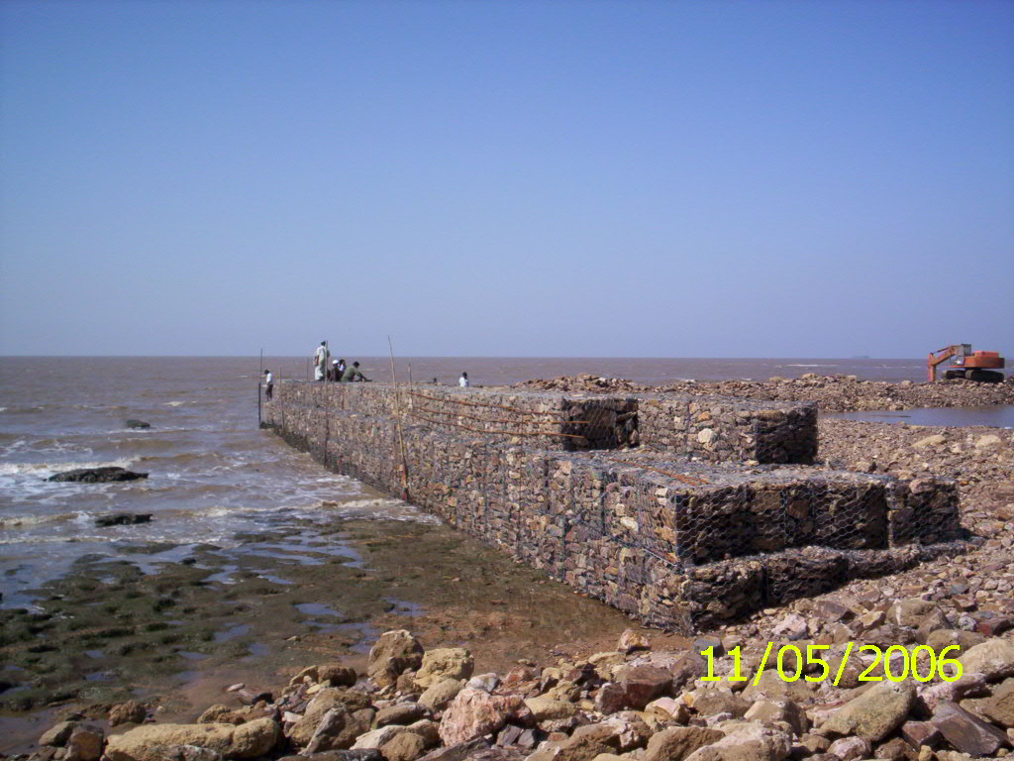
Jetty, Gujarat

Slide 55

Tensar® Geogrid Reinforced Soil Wall System at CSEB,
– Inner Side View, towards deck slab (Korba, India)

Slide 56

Protection Layer in Landfills, HZL, Visakhapatnam, A.P

Slide 57
Bibliography
BOOK :
ENGINEERING WITH GEOSYNTHETICS- TATA MCGRAW HILL PUBLICATIONS CO.PVT.LTD,NEW DELH
NET :
THE BOMBAY TEXTILE RESEARCH ASSOCIATION, Mumbai-(www.btraindia.com)
GEOFABRICS LIMITED, U.K (www.geofabrics.com)

Slide 58
THANK YOU

